Slide 1

Discovering Trends in MLS Attendance
Team RCA FC
John Commander
Wusi Fan
Abdul Hussain
Bill Magill

Slide 2
Background & Hypothesis
MLS is the fastest growing pro sports league in the USA
The league attendance average has grown from 16,675 in 2010 to 22,113 in 2017
Atlanta United has achieved astonishing attendance #s in just their first season
48,200 average, highest in US club soccer history
Top 25 in the world for 2017
Hypothesis
Is there a correlation between an MLS team’s average attendance and their home city’s census demographics?
Is there a correlation between an MLS team’s average attendance and their team performance?

Slide 3
Data Sources
MLS Attendance Data 2012-2017
MLS Team Performance Data 2012 – 2017
US Census Data API 2011-2016
Vader Sentiment Analysis and Tweepy

Slide 4
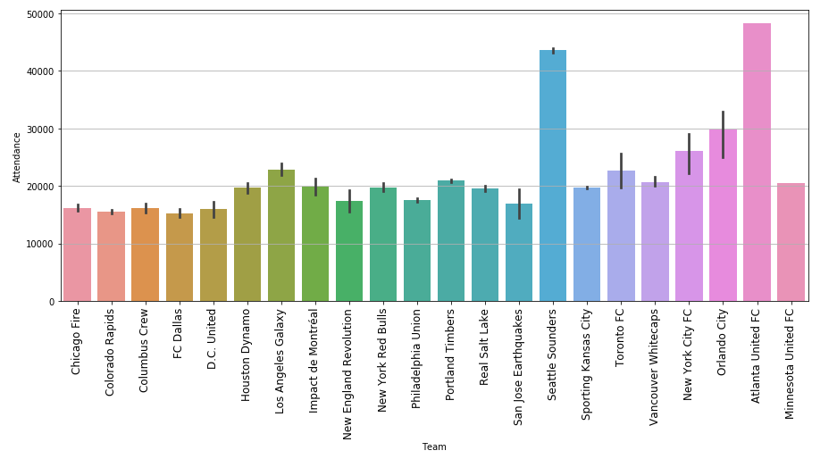
MLS Team Attendance

Slide 5
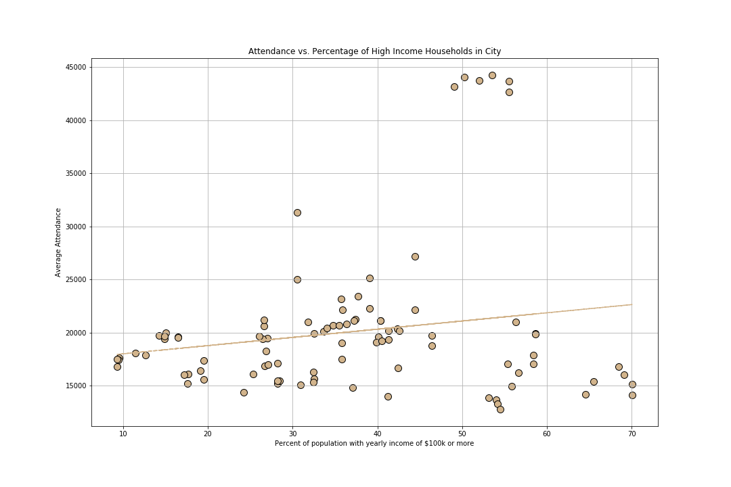
MLS Attendance Data vs High Income

Slide 6
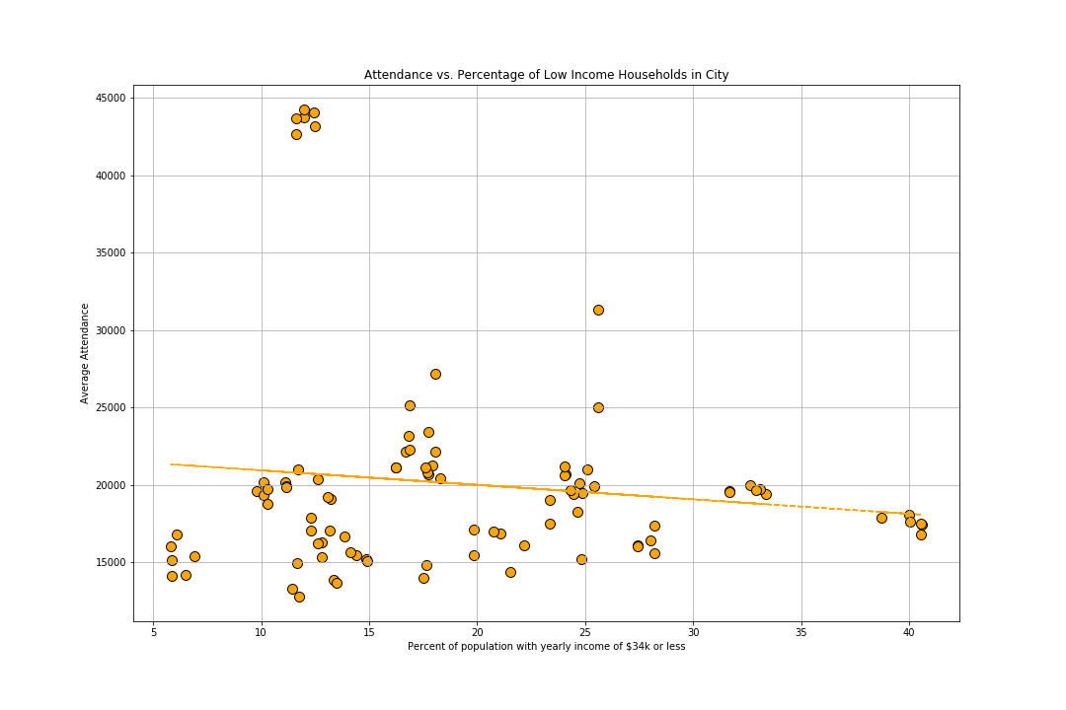
MLS Attendance Data vs Low Income

Slide 7
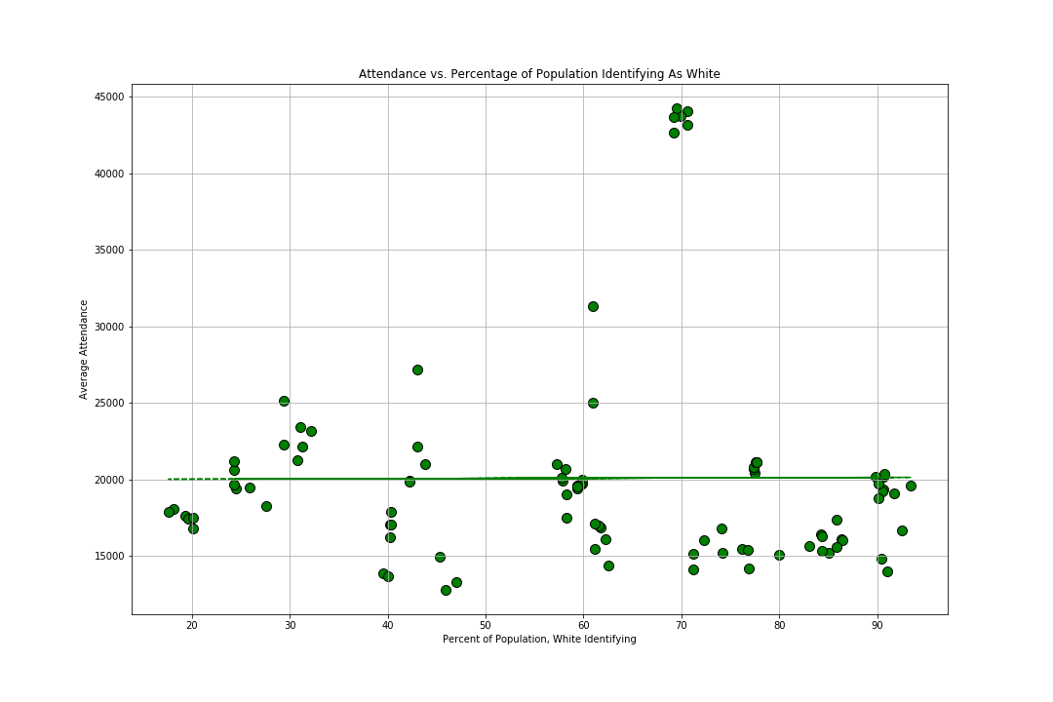
MLS Attendance Data vs Ethnicity – White American

Slide 8
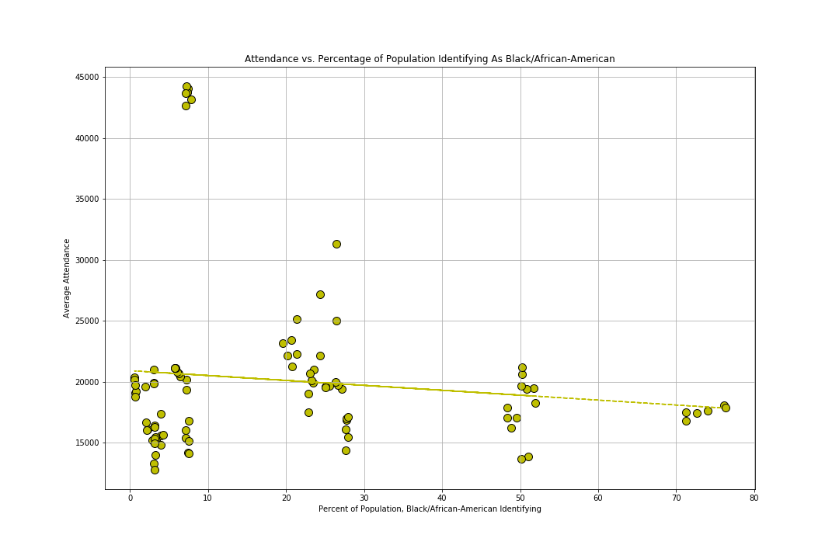
MLS Attendance Data vs Ethnicity –African American

Slide 9
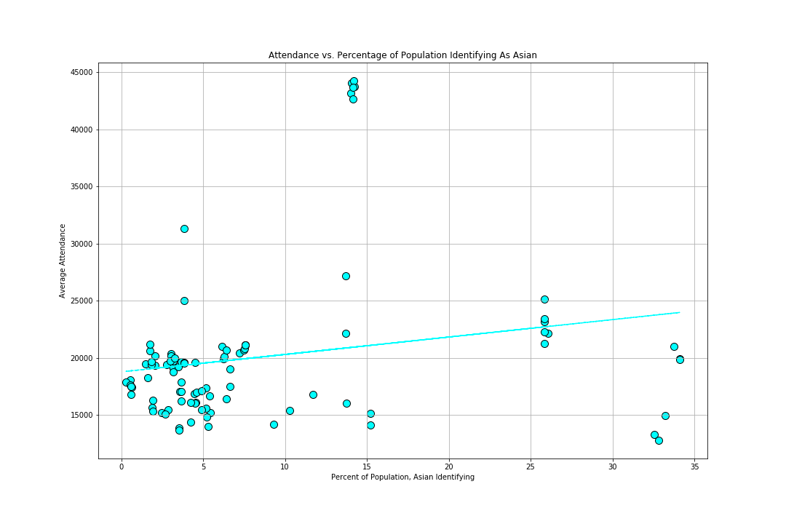
MLS Attendance Data vs Ethnicity –Asian American

Slide 10
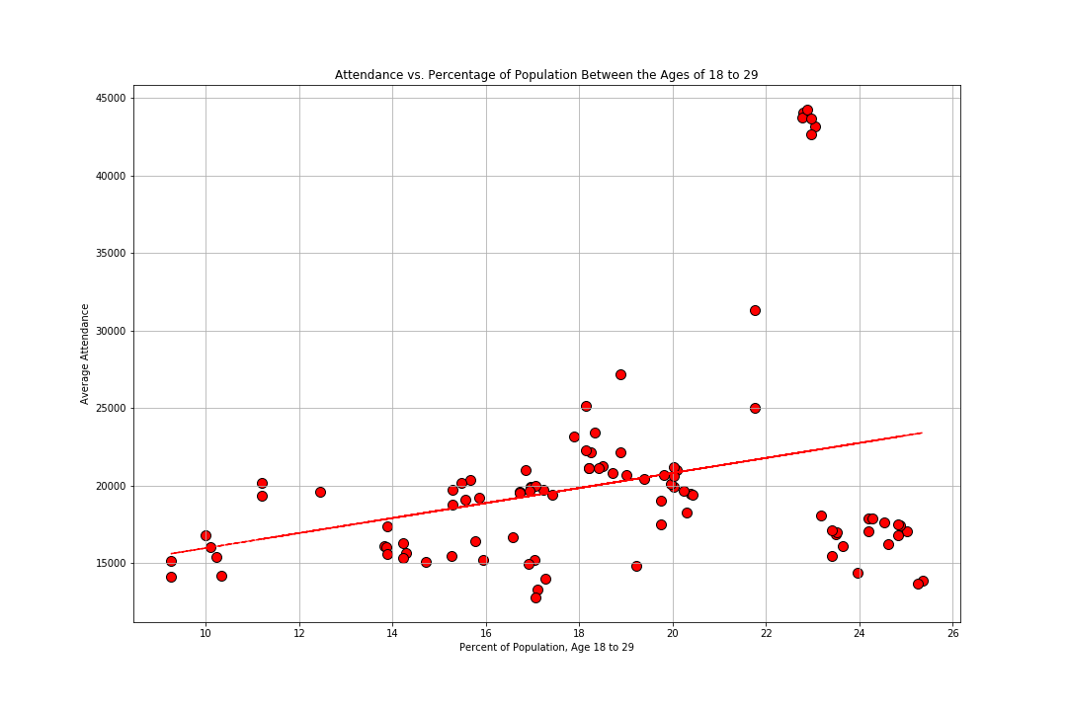
MLS Attendance Data vs Age 18-29

Slide 11
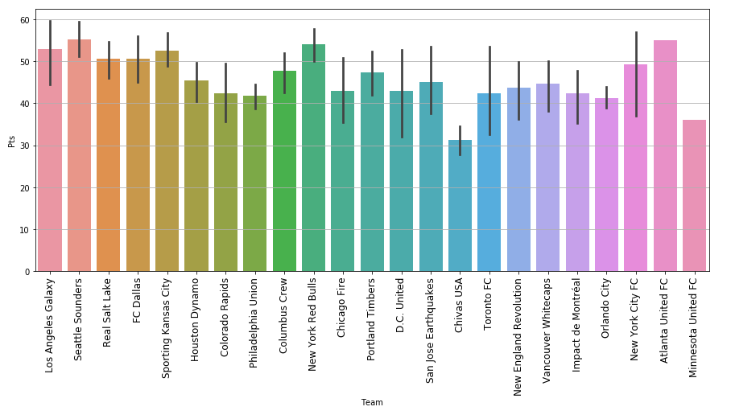
MLS Team Performance

Slide 12
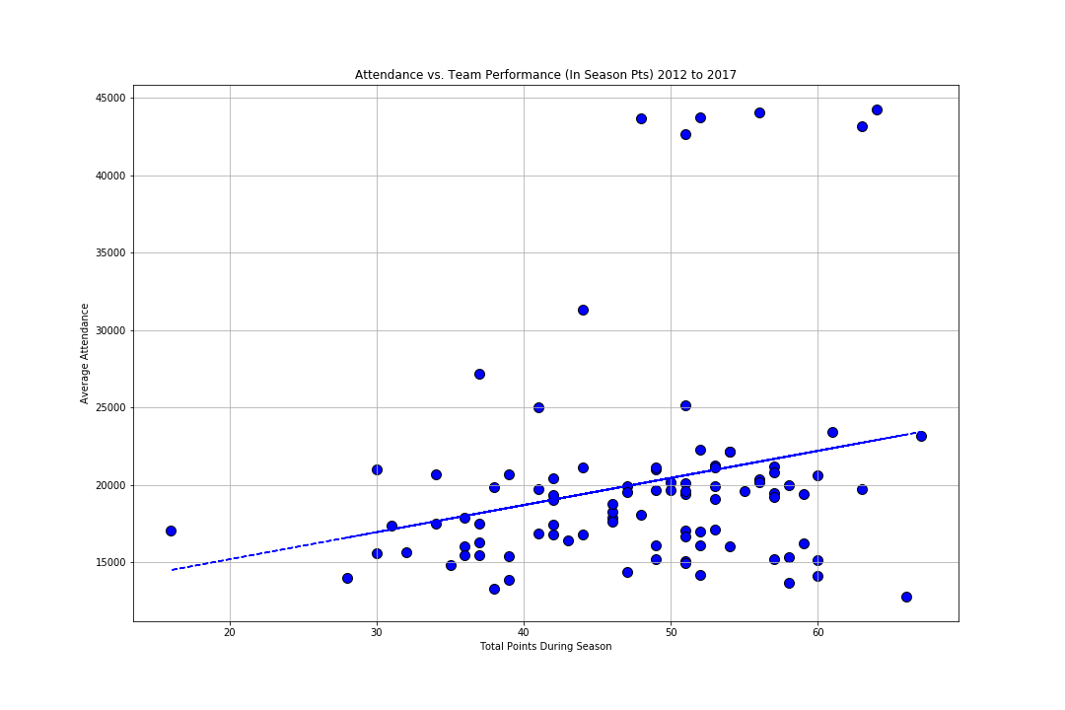
MLS Attendance vs Team Performance

Slide 13
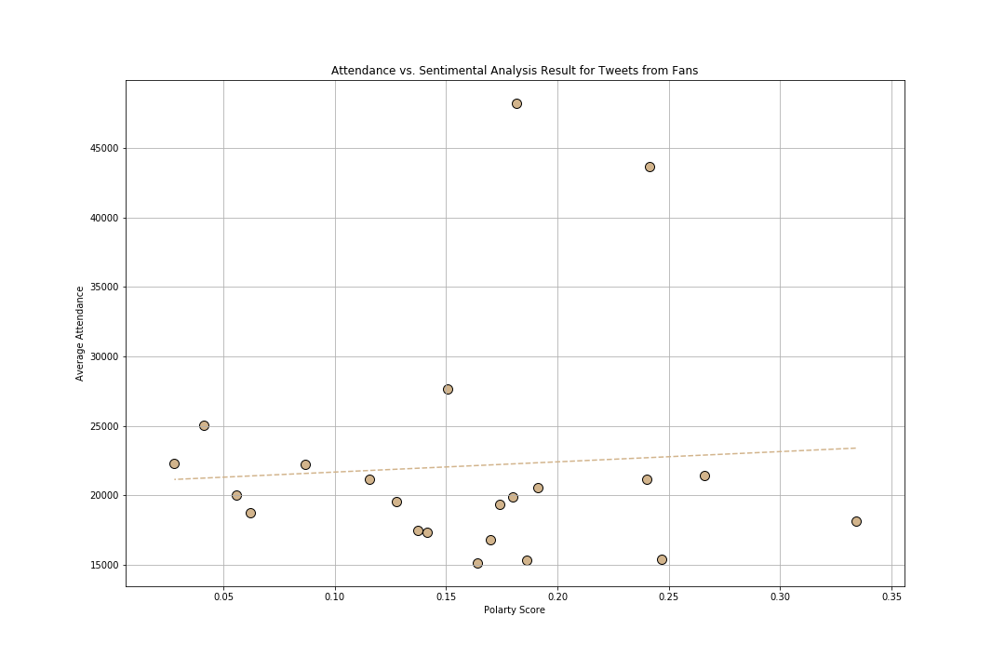
Sentiment Analysis

Slide 14
Conclusions
We found that age, and team performance were the best indicators of MLS Attendance , thus we rejected the null-hypothesis for these variables.
While our variables had low P-Values, the R² values indicated that our model did not accurately represent the data.
Moving forward we would want to explore different models beyond linear.

Slide 15
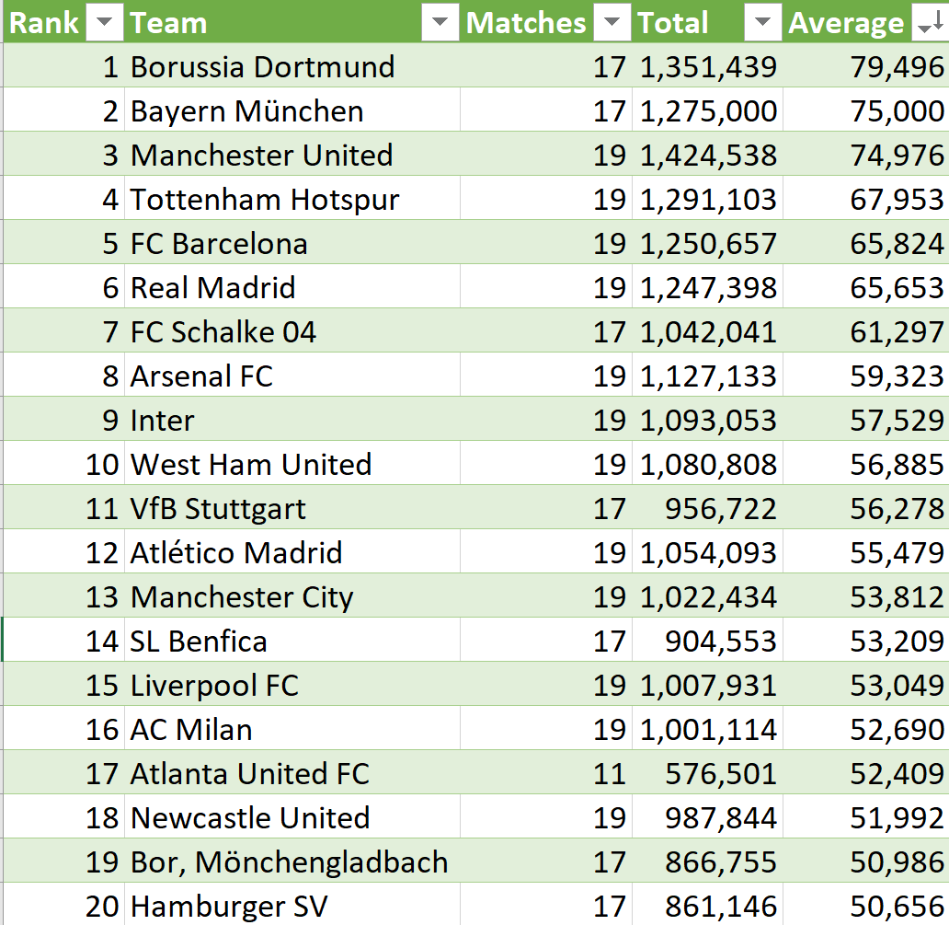
Future Analysis – Atlanta United vs. the World

